Slide 1
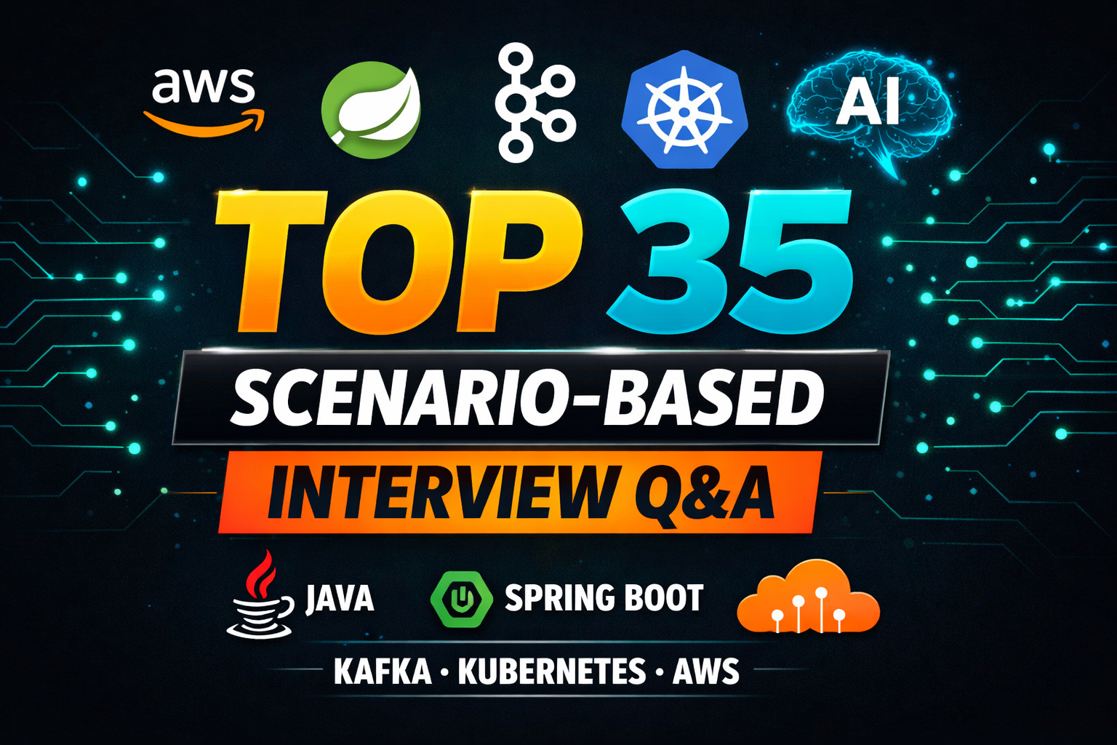

Slide 2
Tell me about yourself
This is Kiran. I have 5+ years of experience working on enterprise and banking applications. I work as a Java backend developer using Core Java, Spring Boot, and microservices.
In my current role, I develop REST APIs, integrate with internal and third-party systems, and handle production issues.
For microservices communication, we use REST and Kafka. APIs are secured using JWT & OAuth2.
For monitoring and observability, we use Splunk or ELK/CloudWatch for logging, Grafana for metrics, and Zipkin for distributed tracing.
I have hands-on experience with Docker, Kubernetes, and AWS services like EC2, EKS, RDS, and S3. I also work with CI/CD pipelines and support zero-downtime deployments.
Currently, I’m working on a project called XYZ, a banking solution used by customers in the US and Australia.
That’s all from my side. Please let me know if you’d like to discuss anything specific.

Slide 3
Explain your project flow or high-level architecture.
Our application uses a microservices architecture. All requests first go through an API Gateway, where authentication and authorization are handled. The gateway routes requests to the required microservices. Each microservice handles one business function and has its own database. Services communicate using REST APIs for synchronous calls and Kafka for asynchronous processing. We use centralized logging and monitoring to track issues. CI/CD pipelines and cloud infrastructure are used for deployment, scaling, and reliability.

Slide 4
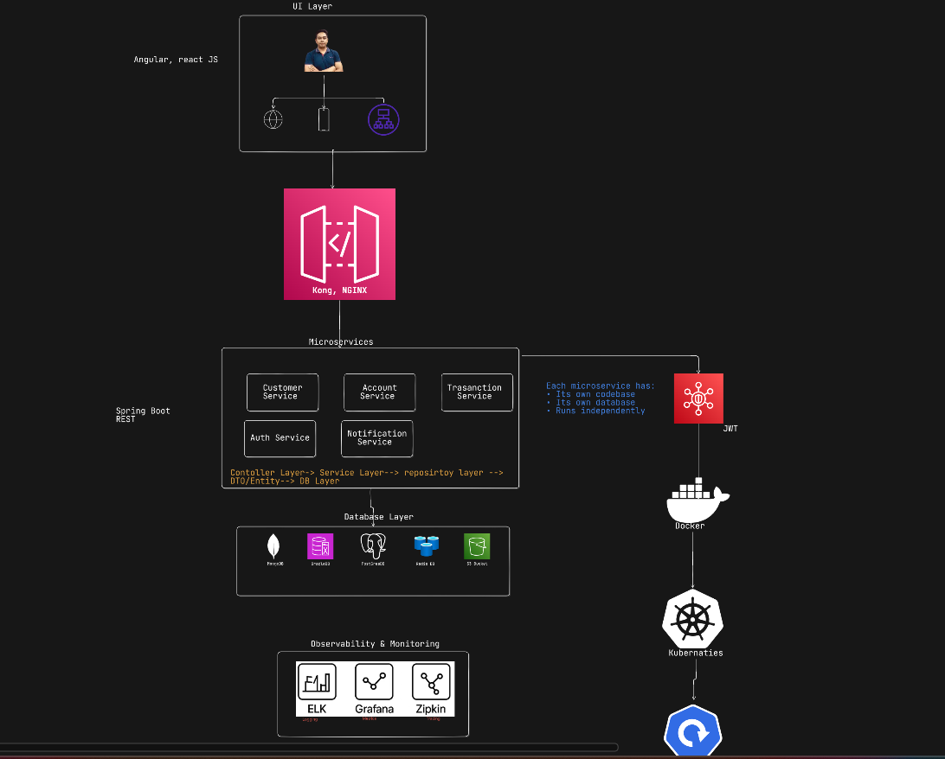

Slide 5
How do different microservices communicate with each other in your system?
We use REST APIs for synchronous communication and Kafka for asynchronous, event-driven workflows. REST is used when an immediate response is required, while Kafka helps reduce coupling and improve scalability.

Slide 6
How do services communicate securely in your system?
We use OAuth2 and JWT tokens. The API Gateway handles authentication, and services validate tokens internally. All communication happens over HTTPS, and sensitive data is encrypted.

Slide 7
Describe a recent challenge you faced and how you fixed it.
We had an issue in production where the application was slow during peak time. Some users were getting timeouts.
I checked monitoring and logs and found that the database connections were getting used up.
The issue was caused by slow database queries.
I fixed it by optimizing the queries and tuning the database connection pool.
After the fix, the application became stable and response time improved.

Slide 8
How do you approach a production bug from the moment it’s reported?
Assess impact → stabilize system → analyze logs and metrics → reproduce in lower environment → fix → test → deploy → monitor.

Slide 9
A bug occurred only in production—why and how did you debug it?
Production had higher data volume and concurrency. I analyzed logs, recreated load in staging, identified a race condition, and fixed it using thread-safe logic.

Slide 10
Explain a hard-to-debug issue and why it was complex.
A memory leak appeared only after long uptime. Heap dump analysis revealed object retention issues, which were fixed by improving object lifecycle handling.

Slide 11
How do you trace errors across multiple microservices?
By using correlation or trace IDs passed across services and logged consistently.

Slide 12
What techniques help when logs are missing or insufficient?
Use metrics, DB checks, tracing tools, and recreate the issue in a staging environment. Logging is improved afterward.

Slide 13
How do you isolate whether an issue is in code, DB, infra, or external API?
Check application logs, DB performance metrics, infrastructure health, and external API response times.

Slide 14
One microservice goes down—impact and mitigation strategy?
Use fallbacks, retries, circuit breakers, and graceful degradation to prevent full system failure.

Slide 15
How do you prevent cascading failures?
By configuring proper timeouts, retries, circuit breakers, and isolating failures using bulkheads.

Slide 16
An API becomes slow under load—step-by-step diagnosis?
Check metrics → logs → database queries → external API latency → identify and optimize the bottleneck.

Slide 17
How do you design schema changes with zero downtime?
I make backward-compatible changes, release in steps, and monitor to ensure zero downtime.

Slide 18
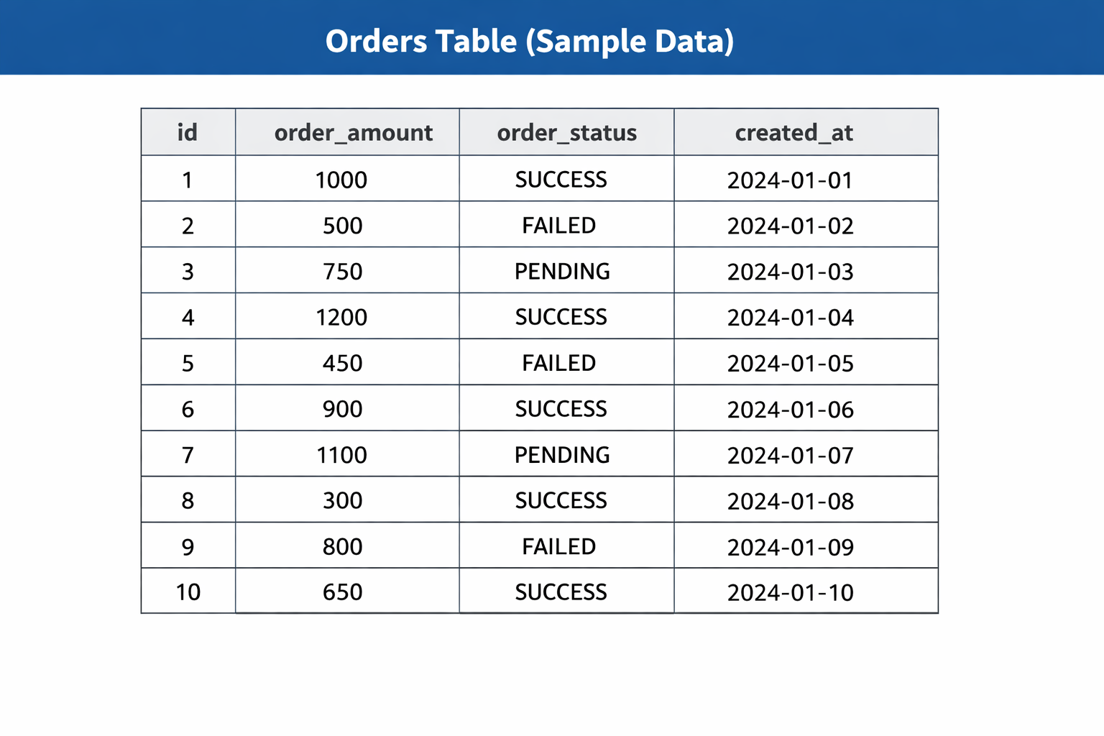
How do you design schema changes with zero downtime?

Slide 19
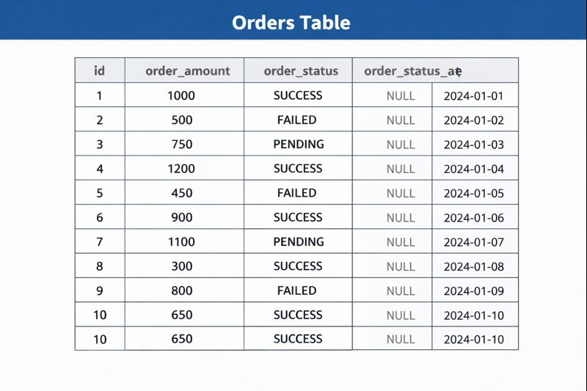
How do you design schema changes with zero downtime?

Slide 20
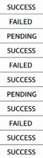
How do you design schema changes with zero downtime?

Slide 21
Explain a database production issue you fixed.
The application was slow in production during peak hours, and users faced timeouts.

Slide 22
Explain a database production issue you fixed.
Problem: The application was slow in production during peak hours, and users faced timeouts.
Investigation: I checked logs and monitoring and found that database connections were getting exhausted due to slow queries.
Fix: I optimized the queries by adding proper indexes and tuned the connection pool.
Result: Performance improved, timeouts stopped, and the system became stable.

Slide 23
How is Kafka used in your project?
We use Kafka for event-driven communication between microservices to improve scalability, reliability, and performance.

Slide 24
How is Kafka used in your project?
Example: Money transfer flow (Monaja → Friend): Mobile App → Fund Service → Account Service → Transaction Service → Notification Service
Without Kafka: Transaction waits for Notification → slow or failure if notification is down.
Mobile App → Fund Service → Account Service → Transaction Service → Kafka → Notification Service
With Kafka: Transaction publishes event to Kafka → user gets success immediately → notification runs separately and retries if needed.
Result: ✅ Loose coupling ✅ To handle high traffic reliably ✅ To improve performance by avoiding synchronous calls

Slide 25
How do you handle message failures and retries?
Retry mechanism
Dead Letter Topic (DLT)
Idempotent processing
Proper error handling & logging
Monitoring & alerting

Slide 26
How do you handle message failures and retries?
Retry mechanism If a consumer fails to process a message, it retries automatically with a configured retry count and delay.
Dead Letter Topic (DLT) If retries are exhausted, the message is sent to a DLT so it is not lost and does not block other messages.
Idempotent processing Consumers are designed to safely handle duplicate messages without creating duplicate actions.
Proper error handling & logging Errors are logged with enough details to debug and replay failed messages.
Monitoring & alerting We monitor failed messages and DLT events and fix issues quickly.

Slide 27
How do you ensure exactly-once or at-least-once processing?
At-least-once processing
We commit Kafka offsets only after successful processing.
If a failure happens before commit, the message is reprocessed.
Consumers are idempotent, so duplicate messages don’t cause issues.
Exactly-once processing
We use Apache Kafka transactions.
Producer writes messages transactionally.
Consumer processes and commits offsets within the same transaction.
This ensures the message is processed only once.

Slide 28
How do you debug consumer lag or slow processing?
I debug Kafka consumer issues by checking lag, logs, slow processing logic, tuning consumer configs, scaling consumers/partitions, and monitoring infra resources.

Slide 29
How do you debug consumer lag or slow processing?
I first check consumer lag in Apache Kafka to see how many messages are pending.
I check application logs to find errors, retries, or exceptions in the consumer.
I verify if the consumer is slow because of business logic, like DB calls or external APIs.
I check consumer configuration (poll interval, max records, concurrency).
If needed, I scale consumers or add partitions to process messages faster.
I monitor CPU, memory, and database performance to rule out infra issues.

Slide 30
Describe a Kafka-related production issue you resolved.
Problem: In production, Kafka consumer lag was increasing, and messages were getting delayed.
Investigation: I checked lag metrics and logs and found that the consumer was processing messages slowly due to a slow database call.
Fix: I optimized the database query and increased consumer concurrency. I also adjusted poll settings.
Result: Consumer lag reduced, messages were processed on time, and the system became stable.

Slide 31
How do you containerize and optimize Spring Boot apps using Docker?
I optimize Docker images using multi-stage builds, lightweight base images, environment-based configuration, and JVM memory tuning.

Slide 32
How do you containerize and optimize Spring Boot apps using Docker?
I use multi-stage builds to keep the Docker image small.
I use lightweight base images to reduce image size.
I pass configuration using environment variables.
I tune JVM memory settings for better container performance.

Slide 33
What Docker issues have you faced in production?
I handled Docker production issues like container OOM by tuning JVM memory, reduced large image size using multi-stage builds and lightweight images, and fixed config failures by standardizing and validating environment variables.

Slide 34
What Docker issues have you faced in production?
High memory usage / container OOM
Issue: Spring Boot container was getting killed due to high memory.
Fix: Tuned JVM memory settings (-Xmx, container-aware JVM options).
Large Docker image size
Issue: Images were slow to pull and deploy.
Fix: Used multi-stage builds and lightweight base images.
Environment config issues
Issue: App failed due to wrong env variables in containers.
Fix: Standardized env configs and validated at startup.

Slide 35
How does Kubernetes handle self-healing and scaling?
Kubernetes provides self-healing by restarting failed pods and scaling by automatically increasing or decreasing pods based on load.

Slide 36
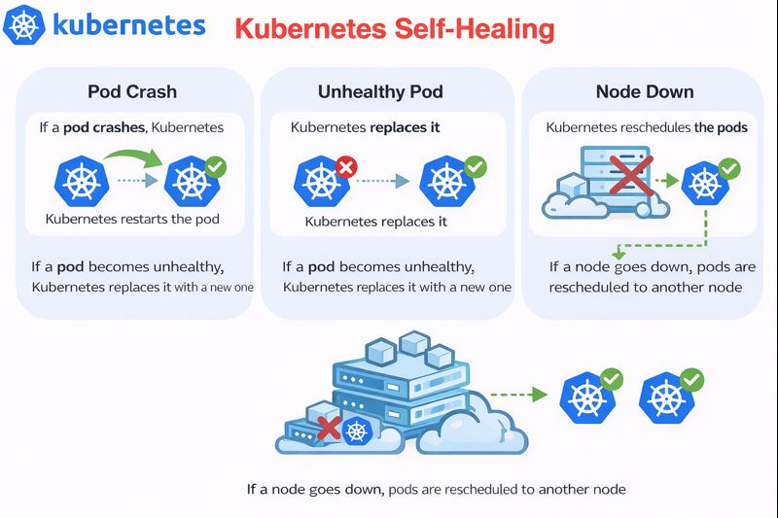

Slide 37
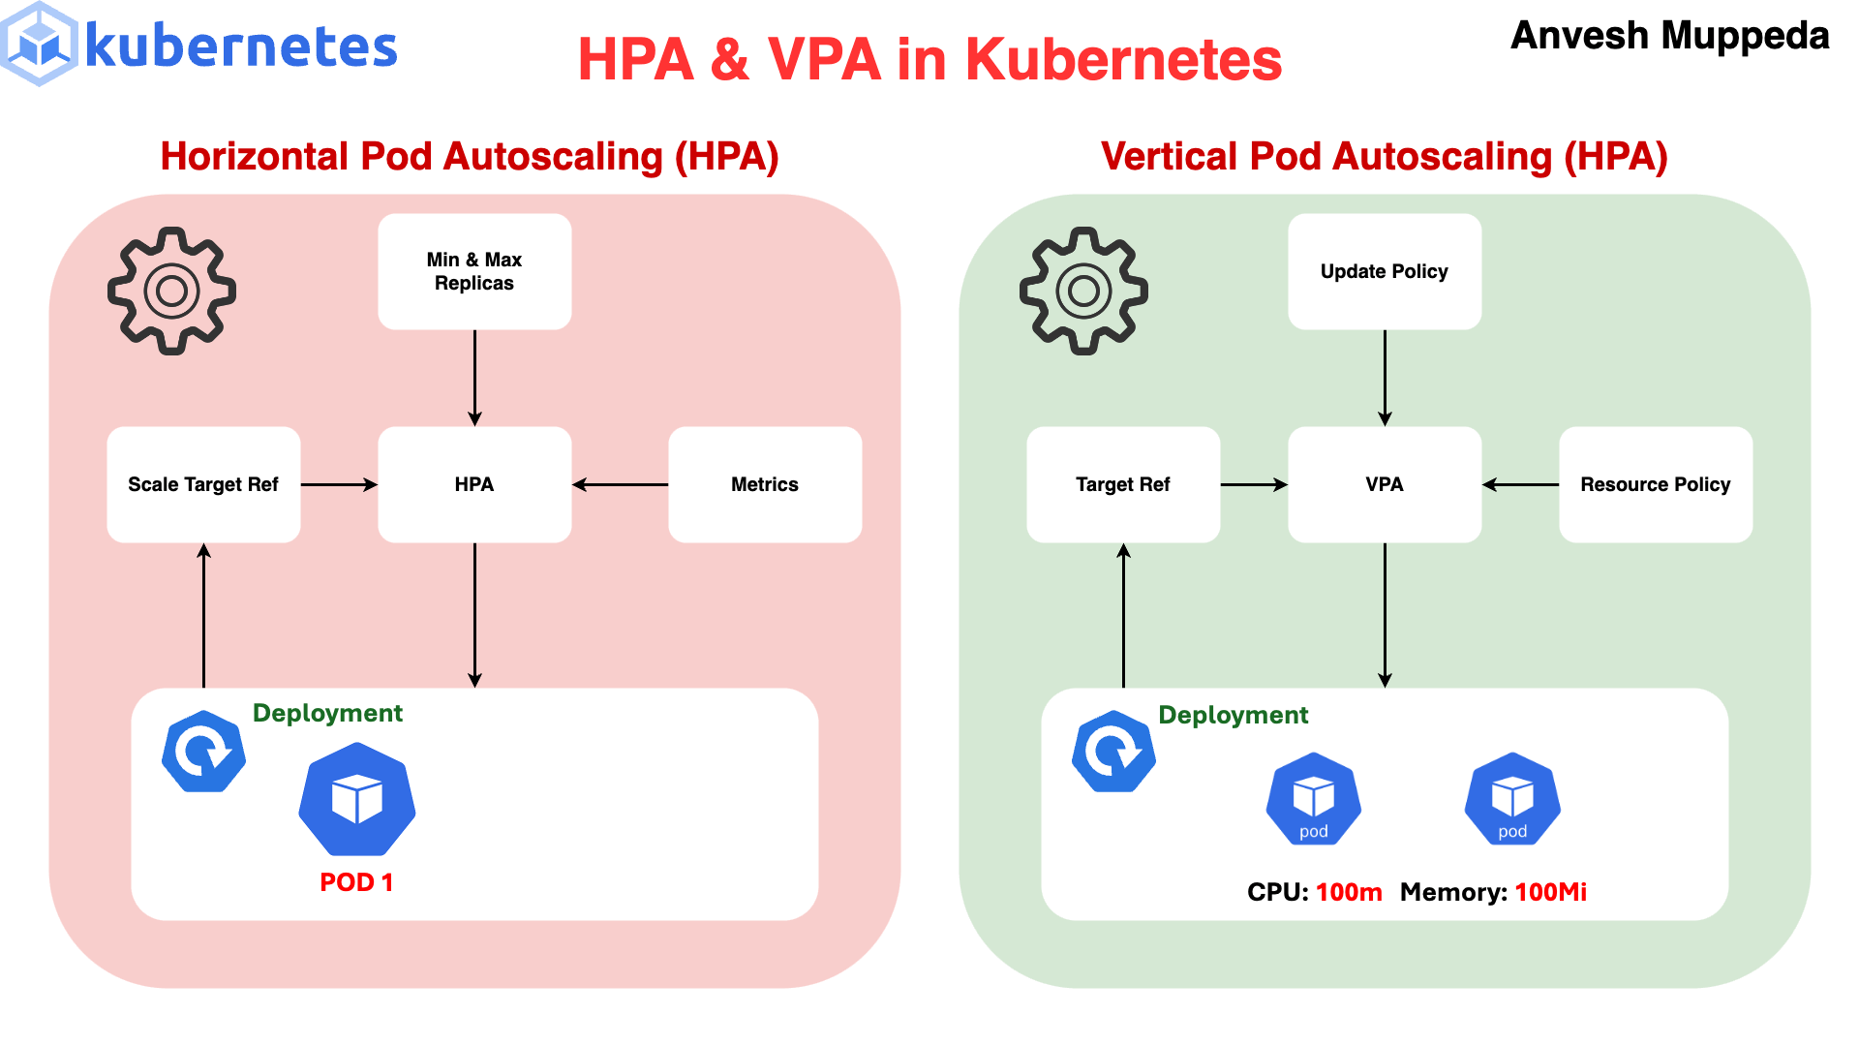

Slide 38
How do you manage config and secrets in Kubernetes?
I manage application config using ConfigMaps and sensitive data using Secrets, injected securely into pods and protected using RBAC.

Slide 39
🔧 Configuration (non-sensitive data)
I use ConfigMaps to store configs like URLs, feature flags, and environment values.
These are injected into pods as environment variables or files.
📌 Example: DB host, app name, log level.
🔐 Secrets (sensitive data)
I use Secrets to store passwords, tokens, and API keys.
Secrets are mounted as env variables or volumes and are base64-encoded.
📌 Example: DB password, JWT secret, API keys.

Slide 40
How do you perform zero-downtime deployments using Kubernetes?
We ensure zero-downtime deployments using rolling updates, readiness and liveness probes, multiple replicas, graceful shutdown, and Blue-Green deployment for instant traffic switching.

Slide 41
How do you perform zero-downtime deployments using Kubernetes?
Rolling updates – Pods are updated one by one, so users are not impacted.
Readiness probes – Traffic goes only to pods that are ready.
Liveness probes – Unhealthy pods are restarted automatically.
Multiple replicas – More than one pod always serves traffic.
Graceful shutdown – Pods finish current requests before stopping.
Blue-Green deployment – Two versions run and traffic is switched instantly for zero downtime.

Slide 42

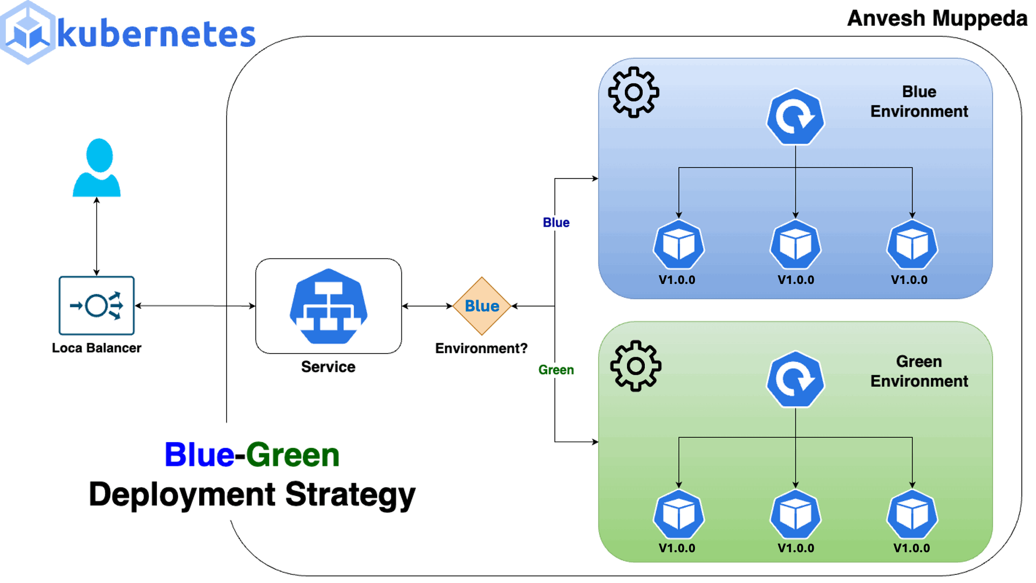

Slide 43
Describe a deployment failure and recovery approach.
When a deployment failed, we rolled back instantly using Blue-Green deployment, fixed the issue, and redeployed safely.

Slide 44
Describe a deployment failure and recovery approach.
Failure: After deploying a new version, users started getting errors because of a configuration issue.
Detection: Monitoring alerts and logs showed increased error rates right after deployment.
Recovery: We immediately switched traffic back using Blue-Green deployment, restoring the old stable version.
Fix: We corrected the configuration, tested again, and redeployed safely.
Result: Service was restored quickly with no downtime and minimal user impact.

Slide 45
What is your rollback strategy?
Our rollback strategy is to instantly switch traffic back to the previous stable version using Blue-Green deployment.

Slide 46
What is your rollback strategy?
We mainly use Blue-Green deployment for rollback.
If a new release has issues, we switch traffic back to the old (Blue) version immediately.
This rollback is fast and causes no downtime for users.
We analyze logs and metrics to find the root cause.
After fixing the issue, we redeploy and switch traffic again.

Slide 47
Why was a bug not caught in testing, and what improved after?
The bug was missed due to limited test coverage, and we improved by adding better tests, realistic data, and monitoring.

Slide 48
Why was a bug not caught in testing, and what improved after?
Why it was missed:
The bug occurred only in production-like data and load, which was not fully covered in testing.
Test cases did not include this specific edge case.
What we improved:
Added new test cases for the missed scenario.
Improved pre-production testing with realistic data.
Added monitoring and alerts to detect such issues early.

Slide 49
Which AWS services are you using and why?
We use EC2/EKS for compute, RDS for databases, S3 for storage, IAM for security, CloudWatch for monitoring, and ELK for centralized logging and analysis.

Slide 50
Which AWS services are you using and why?
Amazon EC2 – To run application servers.
Amazon EKS – To deploy and manage containerized applications.
Amazon RDS – For managed relational databases.
Amazon S3 – To store files, logs, and backups.
AWS IAM – To manage access and security.
Amazon CloudWatch – For monitoring logs, metrics, and alerts.
ELK Stack – For centralized logging, search, and log analysis.

Slide 51
How do you design for high availability and scalability on AWS?
I design for high availability and scalability using Multi-AZ setup, load balancing, auto scaling, EKS, managed databases, and continuous monitoring on AWS.

Slide 52
How do you design for high availability and scalability on AWS?
Multi-AZ deployment I deploy applications and databases across multiple Availability Zones so the system stays up
even if one AZ fails.
Load Balancer I use Elastic Load Balancing to distribute traffic across multiple instances or pods.
Auto Scaling I use Amazon Auto Scaling to automatically add or remove instances based on traffic.
Container orchestration I run services on Amazon EKS, which handles pod scaling and self-healing.
Managed databases I use Amazon RDS with Multi-AZ and read replicas for availability and scaling.
Caching & async processing I reduce load using caching and asynchronous processing where needed.
Monitoring & alerts I monitor the system using Amazon CloudWatch and scale proactively.

Slide 53
How do you handle AWS outages or service limits?
I handle AWS outages and limits using Multi-AZ design, auto scaling, monitoring, graceful fallbacks, and proactive limit management.

Slide 54
How do you handle AWS outages or service limits?
Multi-AZ setup I deploy applications and databases across multiple Availability Zones so traffic continues even if one AZ goes down.
Auto scaling & failover I rely on auto scaling and managed services to automatically recover from instance or pod failures.
Graceful degradation If a dependent AWS service is unavailable, the application handles it gracefully (timeouts, retries, fallback responses).
Monitoring & alerts I use Amazon CloudWatch to detect outages early and take action.
Service limits management I monitor AWS service limits and request limit increases in advance to avoid throttling issues.
Backup & recovery Regular backups and disaster recovery plans ensure quick restoration if needed.

Slide 55
How do you use AI tools (ChatGPT, Copilot, etc.) in development and debugging?
I use AI tools like ChatGPT and Copilot to work faster.
They help me understand requirements and plan the logic.
I use AI to write basic and repetitive code.
During bugs, AI helps me understand errors and logs.
I use AI to clean and improve my code.
AI helps me write test cases and cover edge cases.

Slide 56
What are the AI tools you are using in your project?
AI tools used in my project:
ChatGPT – Used for problem solving, logic clarity, and understanding errors
GitHub Copilot – Works as an AI pair programmer to write code faster
Spring AI – Used to build AI-powered Java and Spring Boot applications
SonarQube – Used for code quality checks and security issues

Slide 57
How do you ensure AI-assisted code is secure, optimized, and production-ready?
Manual review first – I never trust AI output blindly; I review logic, edge cases, and business rules.
Security checks – I validate inputs, avoid hard-coded secrets, and follow secure coding practices.
Code quality scan – I run static analysis using SonarQube to detect bugs, vulnerabilities, and code smells.
Performance validation – I review database queries, loops, and memory usage.
Production mindset – I add proper logging, test with real scenarios, and monitor after deployment.

Slide 58
Thank You…

